Slide 1
Get ready. Get Agile.
USING AGILE METHODS IN A DIGITAL TECHNOLOGIES CLASSROOM
PART 10: DEVELOPING A CLASS KANBAN BOARD

Slide 2
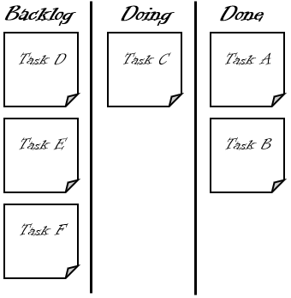
Developing a class Kanban Board
Let’s consider the simplest possible Kanban board:
The columns have meaning:
Backlog: outstanding tasks
In Progress (or Doing): tasks that are being currently working on
Done: finished tasks

Slide 3
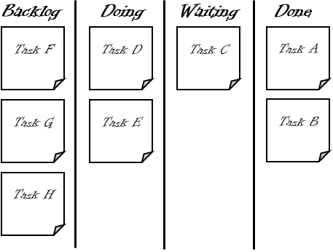
Developing a class Kanban Board
Blocked Tasks
Moving it on a step, teams may find there are tasks that are waiting for a contribution from others and cannot be progressed.
These are said to be Blocked.
Add a new state called Waiting to indicate blockages.

Slide 4
Developing a class Kanban Board
Blocked Tasks
Anything waiting is pulled from Doing to Waiting. It still gives an impression of progress, while clearing reminding the team there is still pending work to finish.
If a Doing column ever becomes empty the first action is now to check Waiting for any task that has now been completed and pull it into Doing, else pull a new task from Backlog.

Slide 5
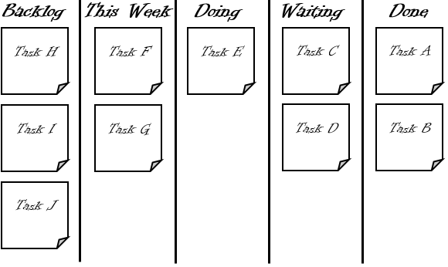
Developing a class Kanban Board
Priority and Timing
Backlogs only work well if priorities have been well organised. A solution to continually having to scan the Backlog, is to implement a Today or This Week column. Remember these headings are contextual and adaptive to class need.

Slide 6
Developing a class Kanban Board
Priority and Timing
Each day(s) or week the Backlog is scanned, and the highest priority tasks are pulled across from the Backlog.
Larger or more complex projects may benefit from further development.

Slide 7
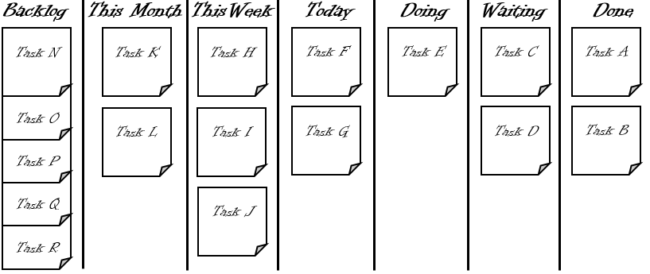
Developing a class Kanban Board
Priority and Timing
Each period tasks are pulled from This Week into the Today column, and as complete pulled into Doing.
Each 1st school day of the month, tasks are pulled from This Month into the This Week column (or maybe each 1st day of a month tasks are pulled from the This Term into the This Month column, etc.).

Slide 8
Developing a class Kanban Board
Priority and Timing
For each last day of the week, the Done column is recorded, emptied, and logged as an overview of what was accomplished during the week.

